Slide 1
AGC with Uncertain Wind Data

Slide 2
Two distinctions
What we think is going to happen tomorrow
What actually happens
Training with available forecasts
Testing with actual data
Modeling errors and differences in training and test scenarios can be viewed as extra forces/disturbances in the system.

Slide 3
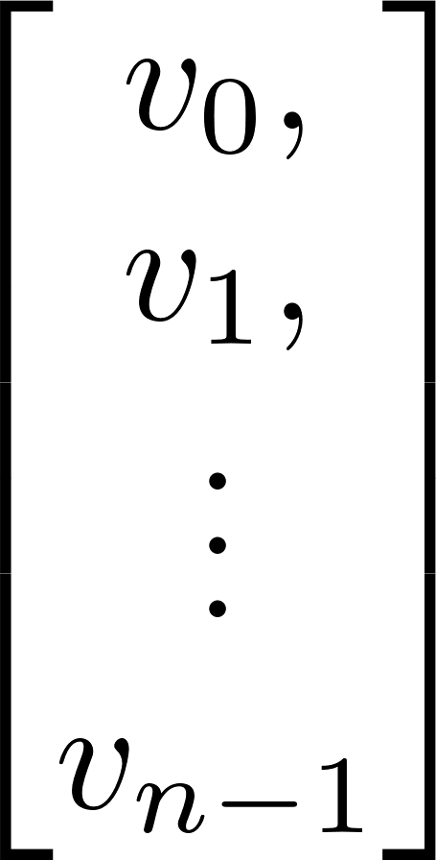
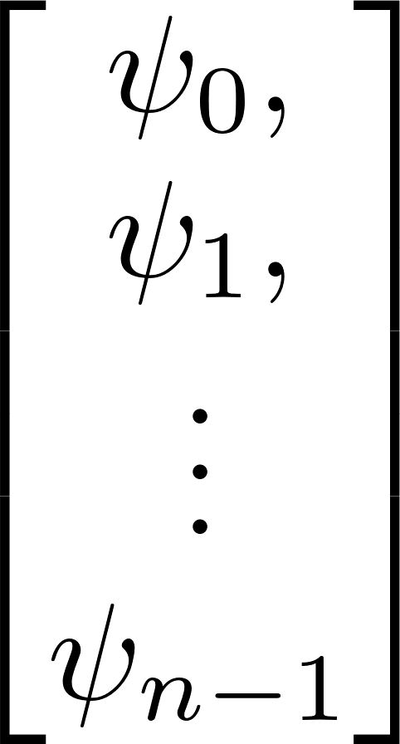
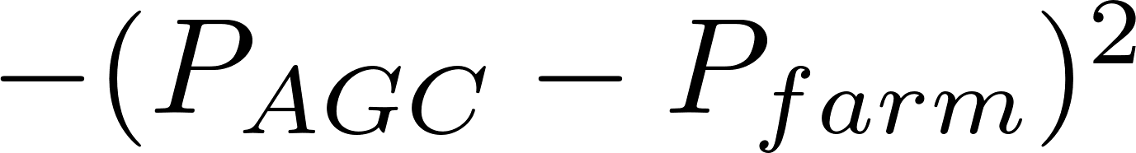
Training phase
Agent
Wind Speed profile
dynFLORIS
disturbance
AGC command

Slide 4
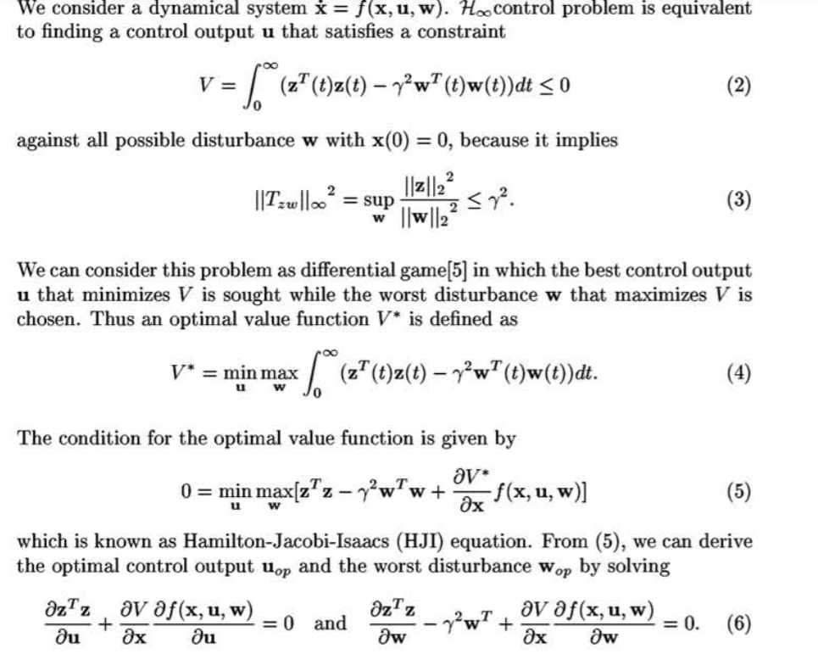
Got to design for worst-case conditions

